Slide 1
Superstore Sales & Profit Dashboard
Interactive dashboard summary created from Sample - Superstore.csv
Objective: Provide actionable insights for business stakeholders

Slide 2
Key Metrics
Total Sales: 2,297,200.86
Total Profit: 286,397.02
Profit Margin: 12.47%
Total Orders: 5,009

Slide 3
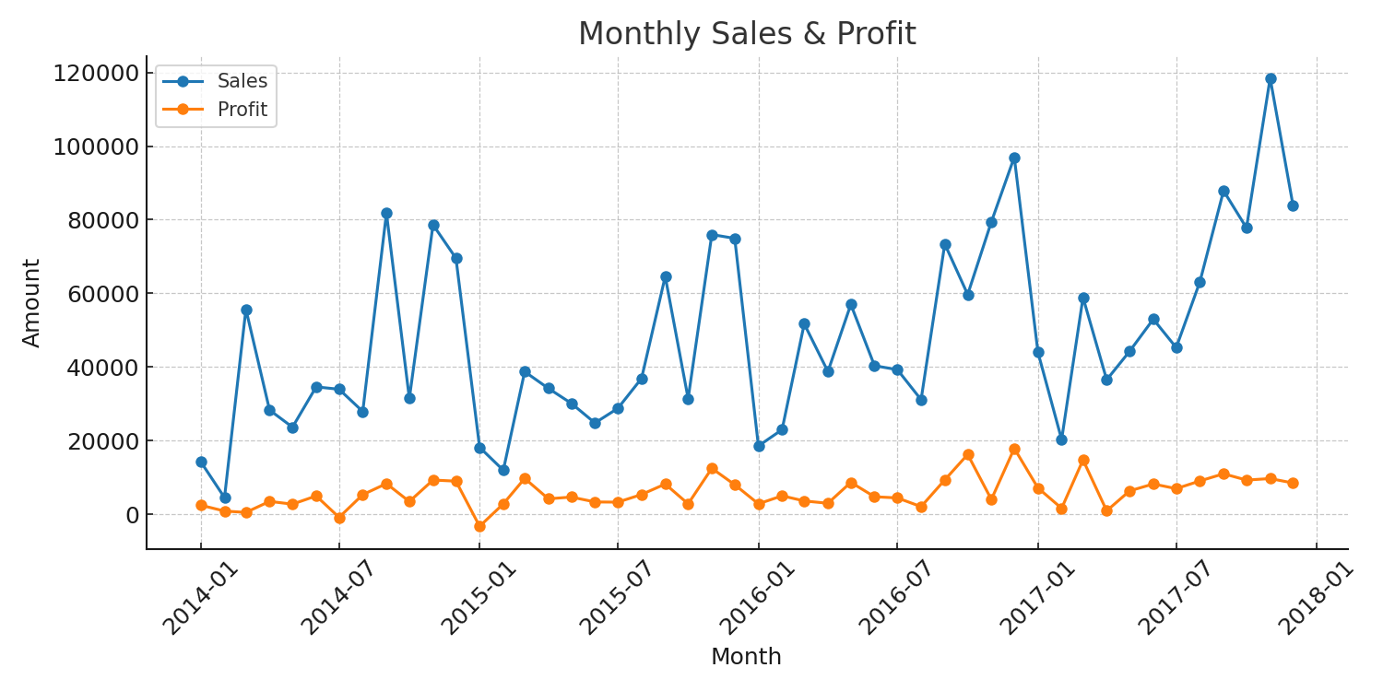
Time-Series Analysis

Slide 4
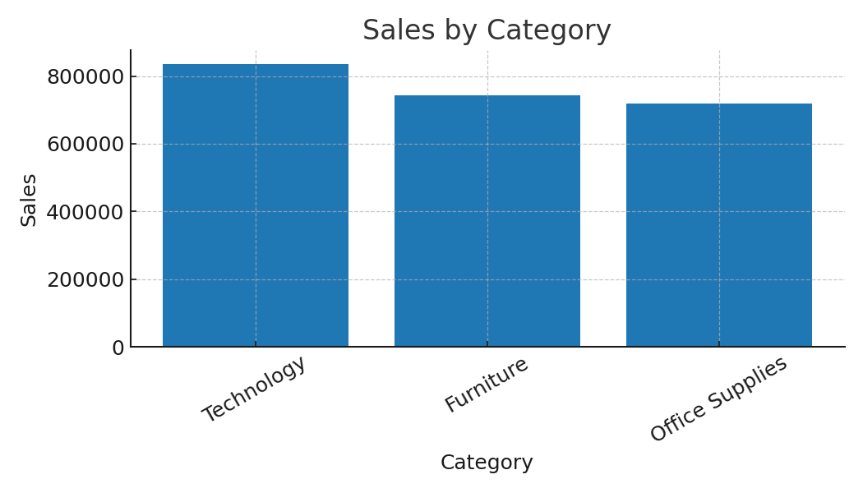
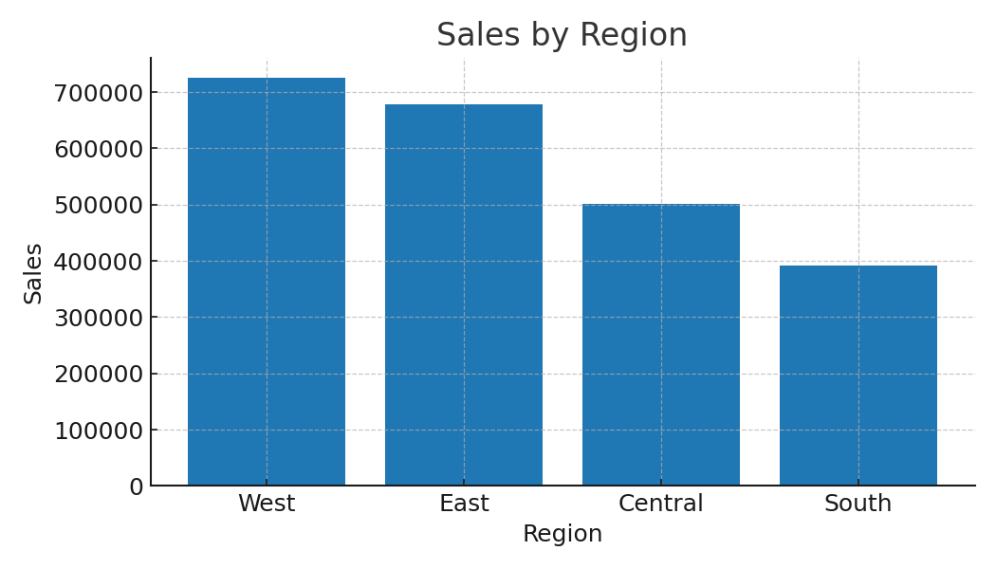
Category & Region Insights

Slide 5
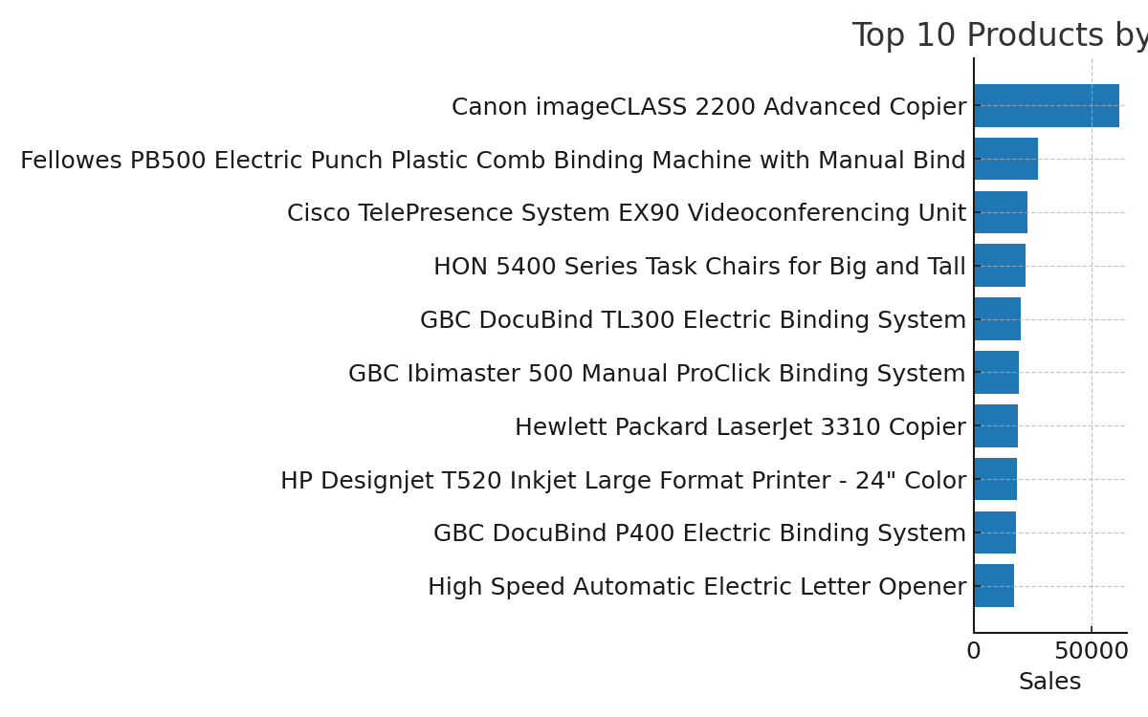
Product Performance

Slide 6
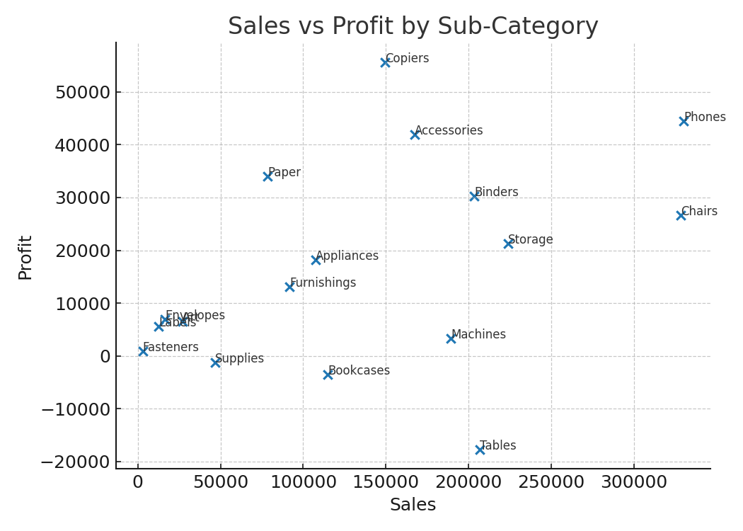
Profitability Analysis

Slide 7
Interactivity & Navigation (Power BI design)
Design notes for Power BI implementation:
- Use slicers for Year, Category, Region, Segment, and Ship Mode.
- Create cards for Total Sales, Total Profit, Profit Margin, Total Orders.
- Add page navigation buttons for Home, Product, Profitability pages.
- Enable drill-through from visuals to detail pages (e.g., Product -> Order details).
- Use a consistent corporate color theme and set it in Power BI Theme JSON.
- Use Bookmarks for pre-set filters and story-telling sequences.

Slide 8
Conclusion & Recommendations
Key recommendations:
- Investigate low-profit products with high sales volume to improve margins.
- Focus marketing efforts on top-performing regions and categories.
- Use monthly trend analysis to plan inventory and promotions around peak months.
- Review shipping modes for cost vs. speed trade-offs impacting profit.

